Slide 1




CS621 Parallel and Distributed Computing
Dr. Muhammad Anwaar Saeed
Dr. Said Nabi
Ms. Hina Ishaq

Slide 2
CS621 Parallel and Distributed Computing
What is replication of data?

Slide 3
Objectives
Concept of Replication of Data.
Replication as Scaling Technique.

Slide 4
What is replication of data?
“Data replication is the process by which data residing on a physical/virtual servers or cloud instance is continuously replicated or copied to a secondary server(s) or cloud instance. Organizations replicate data to support high availability, backup, or disaster recovery.”

Slide 5
Reasons for Replication
Data are replicated to increase the reliability of a system.
Replication for performance:
Scaling in numbers.
Scaling in geographical area.
Replicas allows remote sites to continue working in the event of local failures.
It is also possible to protect against data corruption.
Replicas allow data to reside close to where it is used.

Slide 6
Replication as Scaling Technique
Replication and caching for performance are widely applied as scaling techniques.
Replicating the data and moving it closer to where it is needed helps to solve the scalability problem.
When systems scale:
The first problems to surface are those associated with performance as the systems get bigger, they get often slower.
Another problem is how to efficiently synchronize all of the replicas created to solve the scalability issue?

Slide 7
CS621 Parallel and Distributed Computing
Replication and Consistency

Slide 8
Objectives
Understanding of Replication and Consistency.
Data Consistency Models.

Slide 9
Replication and Consistency
Adding replicas improves scalability but provoke the overhead of keeping the replicas up-to-date. The solution often results in a relaxation of any consistency constraints.
If there are many replicas of the same thing, it is not easy to keep all those replicas consistent. Two principal keys are:
How do we keep all of them up-to-date?
How do we keep the replicas consistent?

Slide 10
Replication and Consistency: Data Consistency Models
Consistency can be achieved in a number of ways. We will study a number of consistency models, as well as protocols for implementing the models.
The consistency models are classified into two broader categories:
Data-centric Consistency Models
Client-Centric Consistency Models

Slide 11
Data Consistency Models
Data-centric Consistency Models
Continuous Consistency
Consistent Ordering of Operations
Causal Consistency
Grouping Operations
Client-Centric Consistency Models
Eventual Consistency
Monotonic Writes
Read Your Writes
Writes Follow Reads

Slide 12
CS621 Parallel and Distributed Computing
Data-Centric Consistency Models: Continuous Consistency

Slide 13
Objectives
Understanding of Data-Centric Consistency Models.
Understanding of Continuous Consistency.
Understanding of Conit with example.

Slide 14
Data Consistency Model
“A contract between processes and the data store that says that if processes agree to obey certain rules, the store promises to work correctly.”

Slide 15
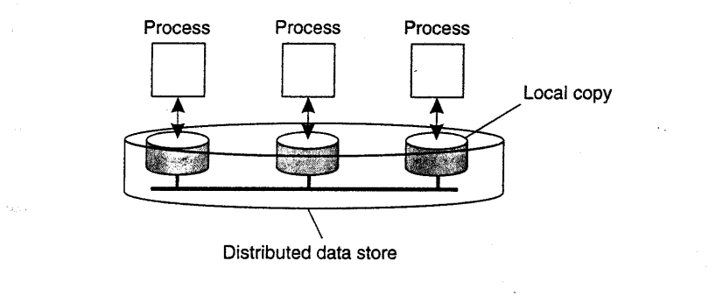
Data-Centric Consistency Models
A data-store can be read from or written to by any process in a distributed system.
A local copy of the data-store (replica) can support “fast reads”.
A write to a local replica needs to be propagated to all remote replicas.
The general organization of a logical data store, physically distributed and replicated across multiple processes.

Slide 16
Data-Centric Consistency Models: Continuous Consistency
Degree of consistency: Yu and Vahdat (2002) take a general approach by distinguishing three independent axes for defining inconsistencies:
Replicas may differ in their numerical value.
Replicas may differ in their relative staleness.
There may differences with respect to order of performed update operations.

Slide 17
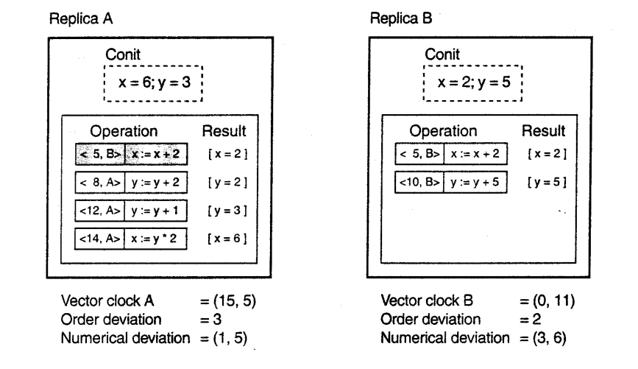
Continuous Consistency: Cont..
A conit specifies the unit over which consistency is to be measured.
Example: numerical and ordering deviations.
  contains the variables x and y:
  Each replica maintains a vector clock
  B sends A operation [h5,Bi: x := x + 2];
  A has made this operation permanent (cannot be rolled back)
  A has three pending operations; order deviation = 3
  A has missed one operation from B, yielding a max diff of 5 units ) (1,5)
An example of keeping track of consistency deviations [adapted from (Yu and Vahdat, 2002)].

Slide 18
CS621 Parallel and Distributed Computing
Data-Centric Consistency Models: Sequential Consistency

Slide 19
Objectives
Introduction of Sequential Consistency.
Example of Sequential Consistency.

Slide 20
Data-Centric Consistency Models: Sequential Consistency
“The result of any execution is the same as if the (read and write) operations by all processes on the data-store were executed in the same sequential order and the operations of each individual process appear in this sequence in the order specified by its program.”

Slide 21
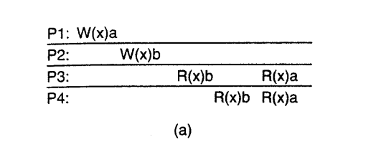
Sequential Consistency Cont…
A weaker consistency model, which represents a relaxation of the rules.
It is also must easier to implement.
Example: Time independent process. Four processes operating on the same data item x.
  Process P1 first performs W(x)a to x.
  Later (in absolute time), process P2 performs a write operation, by setting the value of x to b.
  Both P3 and P4 first read value b, and later value a.
  Write operation of process P2 appears to have taken place before that of P1.
(a) A sequentially consistent data store.

Slide 22
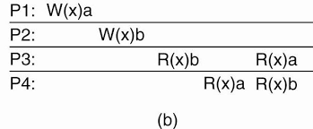
Sequential Consistency Cont…
Example: Time independent process. Four processes operating on the same data item x.
  Violates sequential consistency - not all processes see the same interleaving of write operations.
  To process P3, it appears as if the data item has first been changed to b, and later to a.
  But, P4 will conclude that the final value is b.
(b) A data store that is not sequentially consistent.

Slide 23
CS621 Parallel and Distributed Computing
Data-Centric Consistency Models: Causal Consistency

Slide 24
Objectives
Introduction of Casual Consistency.
Example of Casual Consistency.

Slide 25
Data-Centric Consistency Models: Causal Consistency
For a data store to be considered causally consistent, it is necessary that the store obeys the following condition:
Writes that are potentially causally related must be seen by all processes in the same order.
Concurrent writes may be seen in a different order on different machines.

Slide 26


Causal Consistency Example
Interaction through a distributed shared database.
Process P1 writes data item x.
Then P2 reads x and writes y.
Reading of x and writing of y are potentially causally related because the computation of y may have depended on the value of x as read by P2 (i.e., the value written by P1).
Conversely, if two processes spontaneously and simultaneously write two different data items, these are not causally related.
Operations that are not causally related are said to be concurrent.
For a data store to be considered causally consistent, it is necessary that the store obeys the following condition:
Writes that are potentially causally related must be seen by all processes in the same order.
Concurrent writes may be seen in a different order on different machines.

Slide 27
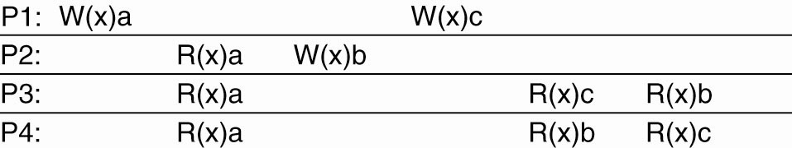
Causal Consistency Example Cont…
Example 1: This sequence is allowed with a causally-consistent store, but not with a sequentially consistent store.

Slide 28
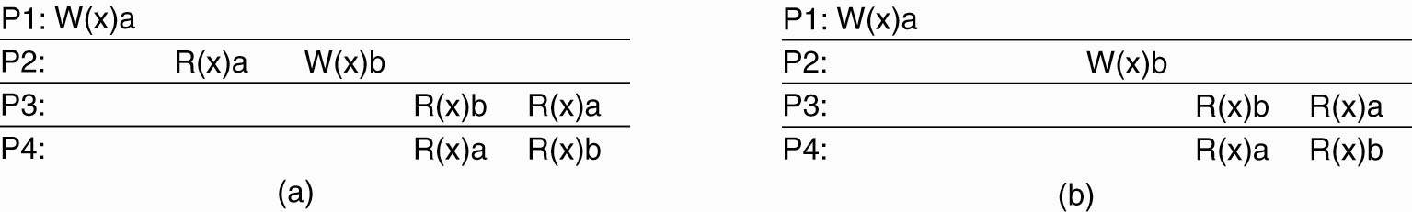
Causal Consistency Example Cont…
Example 2:
W2(x)b potentially depending on W1(x)a because b may result from a computation involving the value read by R2(x)a.
The two writes are causally related, so all processes must see them in the same order.
It is incorrect.
(a) A violation of a causally-consistent store.

Slide 29
Causal Consistency Example Cont…
Example 2:
Read has been removed, so W1(x)a and W2(x)b are now concurrent writes.
A causally-consistent store does not require concurrent writes to be globally ordered,
It is correct.
Note: situation that would not be acceptable for a sequentially consistent store.
(a) A violation of a causally-consistent store.

Slide 30
CS621 Parallel and Distributed Computing
Client-Centric Consistency Models: Eventual Consistency

Slide 31
Objectives
Understanding of Client-Centric Consistency Models.
Understanding of Eventual Consistency.

Slide 32
Client-Centric Consistency Models
“A special class of distributed data-store which is characterized by the lack of simultaneous updates. Here, the emphasis is more on maintaining a consistent view of things for the individual client process that is currently operating on the data-store."

Slide 33
Client-Centric Consistency Models Cont…
Client-centric consistency models are described using the following notations.
X: data item
Xi: ith version of x
WS xi[t] is the set of write operations at Li that lead to version xi of x (at time t);
If operations in WS xi[t1] have also been performed at local copy Lj at a later time t2, we write WS (xi[t1] , xj[t2] ).
If the ordering of operations or the timing is clear from the context, the time index will be omitted.

Slide 34
Client-Centric Consistency Models: Eventual Consistency
“The eventual consistency model states that, when no updates occur for a long period of time, eventually all updates will propagate through the system and all the replicas will be consistent.”

Slide 35
Eventual Consistency Cont…
Client-centric consistency models originate from the work on Bayou.
Bayou is a database system developed for mobile computing, where it is assumed that network connectivity is unreliable and subject to various performance problems.
Wireless networks and networks that span large areas, such as the Internet, fall into this category.
Eventual consistency essentially requires only updates are guaranteed to propagate to all replicas.

Slide 36
Eventual Consistency Example
Example: Consistency for Mobile Users
Consider a distributed database to which you have access through your notebook.
Assume your notebook acts as a front end to the database.
At location A you access the database doing reads and updates.
At location B you continue your work, but unless you access the same server as the one at location A, you may detect inconsistencies:
Your updates at A may not have yet been propagated to B
You may be reading newer entries than the ones available at A
Your updates at B may eventually conflict with those at A

Slide 37
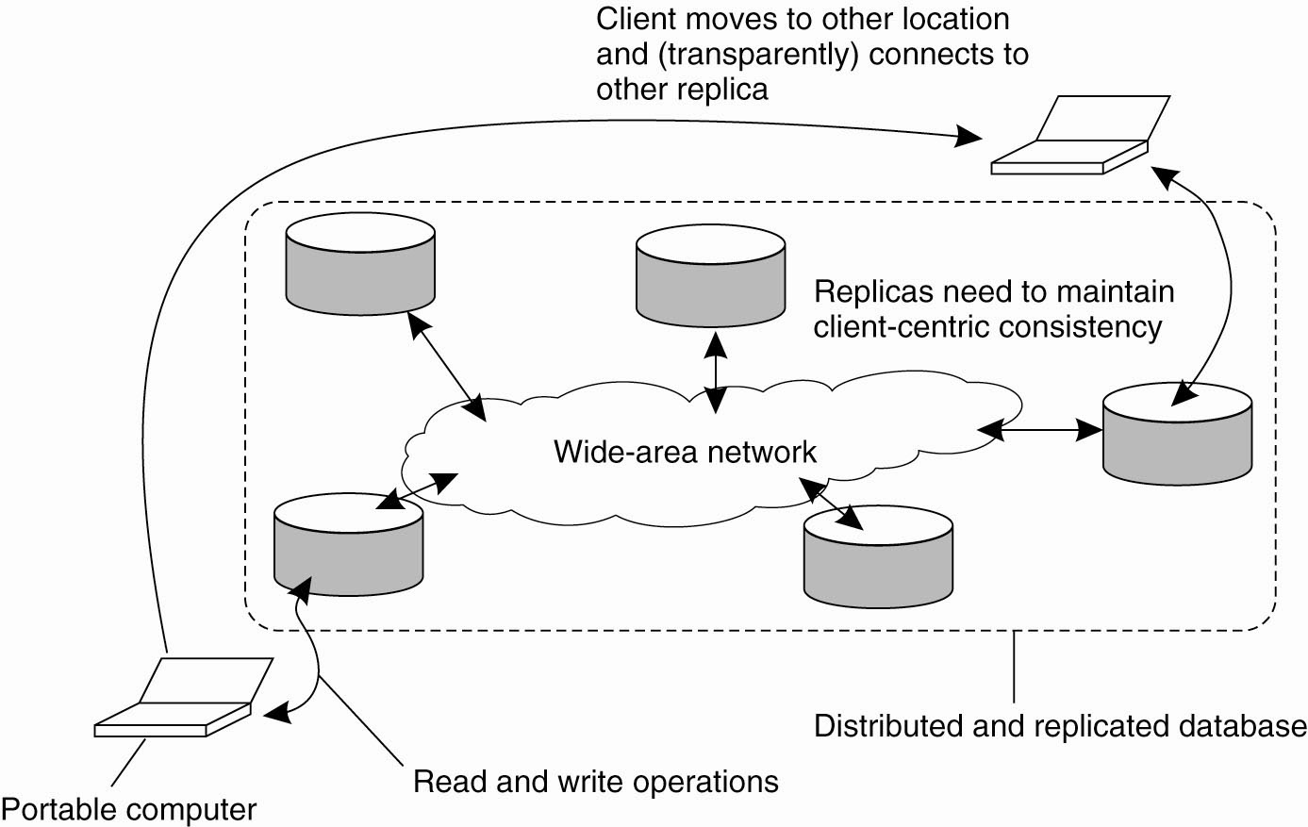
Eventual Consistency Example Cont…
The principle of a mobile user accessing different replicas of a distributed database.

Slide 38
CS621 Parallel and Distributed Computing
Client-Centric Consistency Models: Monotonic Reads

Slide 39
Objectives
Understanding of Monotonic Reads.
Monotonic Reads Example.

Slide 40
Client-Centric Consistency Models: Monotonic Reads
If a process reads the value of a data item x, any successive read operation on x by that process will always return that same or a more recent value.
Monotonic-read consistency guarantees that if a process has seen a value of x at time t, it will never see an older version of x at a later time.

Slide 41
Monotonic Reads Example
Automatically reading your personal calendar updates from different servers. Monotonic Reads guarantees that the user sees all updates, no matter from which server the automatic reading takes place.
Reading (not modifying) incoming mail while you are on the move. Each time you connect to a different e-mail server, that server fetches (at least) all the updates from the server you previously visited.

Slide 42
Monotonic Reads Example Cont…
Example: The read operations performed by a single process P at two different local copies of the same data store.
Vertical axis - two different local copies of the data store are shown - L1 and L2.
Time is shown along the horizontal axis.
Operations carried out by a single process P in boldface are connected by a dashed line representing the order in which they are carried out.

Slide 43
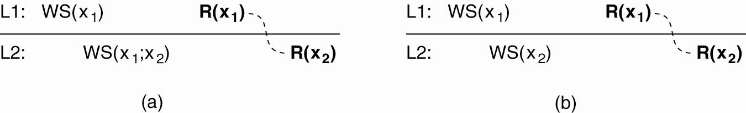
Monotonic Reads Example Cont…
Process P first performs a read operation on x at L1, returning the value of x1 (at that time).
This value results from the write operations in WS (x1) performed at L1.
Later, P performs a read operation on x at L2, shown as R (x2).
To guarantee monotonic-read consistency, all operations in WS (x1) should have been propagated to L2 before the second read operation takes place.
(a) A monotonic-read consistent data store.

Slide 44
Monotonic Reads Example Cont…
Situation in which monotonic-read consistency is not guaranteed.
After process P has read x1 at L1, it later performs the operation R (x2 ) at L2 .
But, only the write operations in WS (x2 ) have been performed at L2 .
No guarantees are given that this set also contains all operations contained in WS (x1).
(b) A data store that does not provide monotonic reads

Slide 45
CS621 Parallel and Distributed Computing
Client-Centric Consistency Models: Monotonic Writes

Slide 46
Objectives
Understanding of Monotonic Writes.
Monotonic Writes Example.

Slide 47
Client-Centric Consistency Models: Monotonic Writes
A write operation by a process on a data item x is completed before any successive write operation on X by the same process.
A write operation on a copy of item x is performed only if that copy has been brought up to date by means of any preceding write operation, which may have taken place on other copies of x. If need be, the new write must wait for old ones to finish.

Slide 48
Monotonic Writes Example
Updating
Updating a program at server S2, and ensuring that all components on which compilation and linking depends, are also placed at S2.
Maintaining
Maintaining versions of replicated files in the correct order everywhere (propagate the previous version to the server where the newest version is installed).

Slide 49
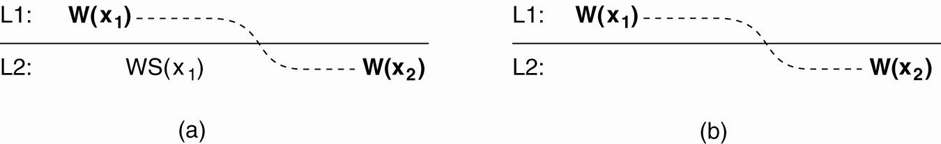
Monotonic Writes Example Cont…
Process P performs a write operation on x at local copy L1, presented as the operation W(x1).
Later, P performs another write operation on x, but this time at L2, shown as W (x2).
To ensure monotonic-write consistency, the previous write operation at L1 must have been propagated to L2.
This explains operation W (x1) at L2, and why it takes place before W (x2).
(a) A monotonic-write consistent data store.

Slide 50
Monotonic Writes Example Cont…
Situation in which monotonic-write consistency is not guaranteed.
Missing is the propagation of W(x1) to copy L2.
No guarantees can be given that the copy of x on which the second write is being performed has the same or more recent value at the time W(x1 ) completed at L1.
(b) A data store that does not provide monotonic-write consistency.

Slide 51
CS621 Parallel and Distributed Computing
Client-Centric Consistency Models: Read Your Writes

Slide 52
Objectives
Understanding of Read Your Writes.
Read Your Writes Example.

Slide 53
"Client-Centric Consistency Models: Read Your Writes
The effect of a write operation by a process on data item x will always be seen by a successive read operation on x by the same process.
A write operation is always completed before a successive read operation by the same process, no matter where that read operation takes place.
Example: Updating your Web page and guaranteeing that your Web browser shows the newest version instead of its cached copy.

Slide 54
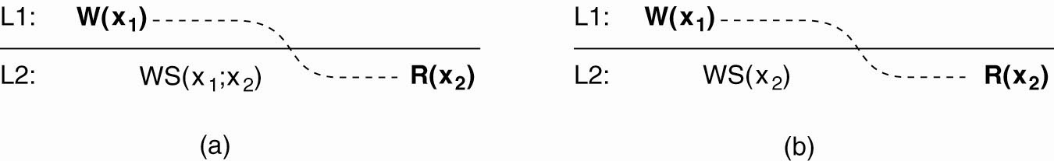
Read Your Writes Example
Process P performed a write operation W(x1) and later a read operation at a different local copy.
Read-your-writes consistency guarantees that the effects of the write operation can be seen by the succeeding read operation.
This is expressed by WS (x1;x2), which states that W (x1) is part of WS (x2).
(a) A data store that provides read-your-writes consistency.

Slide 55
Read Your Writes Example Cont…
W (x1) has been left out of WS (x2), meaning that the effects of the previous write operation by process P have not been propagated to L2.
(b) A data store that does not.

Slide 56
CS621 Parallel and Distributed Computing
Client-Centric Consistency Models: Writes Follow Reads

Slide 57
Objectives
Understanding Writes Follow Reads Model.
Example of Writes Follow Reads Model.

Slide 58
Client-Centric Consistency Models: Writes Follow Reads
A write operation by a process on a data item x following a previous read operation on x by the same process is guaranteed to take place on the same or a more recent value of x that was read.
Any successive write operation by a process on a data item x will be performed on a copy of x that is up to date with the value most recently read by that process.
Example: See reactions to posted articles only if you have the original posting (a read .pulls in. the corresponding write operation).

Slide 59

Writes Follow Reads Example
A process reads x at local copy L1.
The write operations that led to the value just read, also appear in the write set at L2, where the same process later performs a write operation.
(Note that other processes at L2 see those write operations as well.)
(a) A writes-follow-reads consistent data store.

Slide 60
Writes Follow Reads Example Cont…
No guarantees are given that the operation performed at L2,
They are performed on a copy that is consistent with the one just read at L1.
(b) A data store that does not provide writes-follow-reads consistency.

